Slide 1
BENEFICIAL OWNERSHIP – ARE YOU PREPARED? September 19, 2017
Carol Beaumier
Managing Director
Protiviti
Lyn Hall-Fore
US Director of BSA/AML
BBVA

Slide 2
Agenda
Customer Transparency - Background
CDD Regulatory Requirements
Alignment with Other Regulatory Requirements
Best Practices and Recommendations
Where Do We Go From Here?

Slide 3
Customer Transparency
FATF Recommendations 5, 24 and 25
PREVENTIVE MEASURES
5. CDD should include Identifying the beneficial owner, and taking reasonable measures to verify the identity of the beneficial owner, such that the financial institution is satisfied that it knows who the beneficial owner is. For legal persons and arrangements this should include financial institutions understanding the ownership and control structure of the customer
TRANSPARENCY AND BENEFICIAL OWNERSHIP OF LEGAL PERSONS AND ARRANGEMENTS
24. Transparency and beneficial ownership of legal persons: adequate, accurate and timely information on the beneficial ownership and control of legal persons
25. Transparency and beneficial ownership of legal arrangements: adequate, accurate and timely information on express trusts, including information on the settlor, trustee and beneficiaries.

Slide 4
FATF Mutual Evaluation Report 2006
Measure | Rating | Relevant Comments
Customer Due Diligence | PC | No obligation in law or regulation to identify beneficial owners except in very specific circumstances (e.g., correspondent banking and private banking.
Legal Persons | NC | No measures in place to ensure that there is adequate, accurate and timely information on the beneficial ownership and control of legal persons that can be obtained or assessed in a timely fashion by competent authorities.
Legal Arrangements | NC | There is minimal information concerning the beneficial owners of trusts that can be obtained or assessed by the competent authorities in a timely manner.
2014
2012
2010
Notes:
We could say that we started on this path in 1998, but another way to look at this is that the 2006 MER conducted of the US by FATF which criticized the U.S. for falling short of international CDD standards including those for beneficial ownership.
Nothing much happened on this front until 2010 when the bank regulators and the SEC issued joint guidance to their constituents on their expectations that institutions obtain beneficial ownership info on a risk-based basis.
Then two years later, the regulators issued an ANPR suggesting they planned to take a more prescriptive approach.
Which was again confirmed 2 years later in 2014 when they issued the NPR.
Two more years pass and in April of this year the Panama Papers leak and in May we have a final rule.
Would the rule have been finalized anyway? Yes, because without it US would have continued to be criticized by FATF.
Did the Panama Papers leak speed up the release of the final rule? I’ll let you be the judge of that.

Slide 5
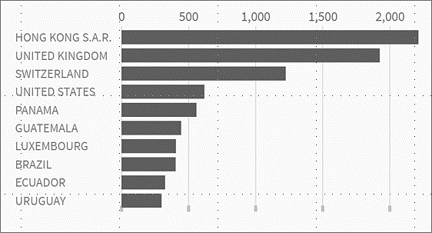
Significance of the Panama Papers
May 2016: The Panama Papers’ leak identifies nearly 214,000 accounts with trillions of dollars in assets that were created by intermediaries in 21 jurisdictions.
Top 10 Jurisdictions
Source: The Panama Papers, ICIJ
The leak sparked outrage over the lack of financial transparency and the ease by which people – good and bad - were able to hide their assets.
Searchable database for the Panama Papers: https://offshoreleaks.icij.org.
Notes:
But, my own view is that the leak probably did serve as a catalyst.
This was a leak of 11.5 million documents 2.6 terabytes of data.
Chinese hackers reportedly stole 50 terabytes of data from U.S. military according to one of the NSA docs leaked by Edward Snowden.
Sony hack a few years ago was reportedly 100 terabytes.
So, not the biggest leak in history, but certainly sizeable.
What the leak disclosed was that more than 214,000 accounts – that word is missing from the slide – with trillions of dollars in assets were opened by some 14,000 intermediaries.
The jurisdictions of the top 10 are on this slide.
Told by a CEO of small OCC-regulated bank that his OCC AML examiner was requiring him to screen his entire customer base against the Panama Papers database.
Know some large domestic banks have done this as well.
If you think your institution has exposure, you may want to screen yourselves.
At a minimum, you want to look at how you are treating offshore jurisdictions and offshore vehicles for risk rating and due diligence purposes.

Slide 6
Speaking of PICs and PEPs . . .
Notes:
And PEPs bring us back to the Panama Papers which in addition to casting a spotlight on offshore centers and vehicles, also shed the spotlight on PEPs.
According to media reports, among the account holders identified through the leak were 140 PEPs – some “good” PEPs, some more questionable, some like Iceland’s Prime Minister who stepped down when the leak revealed that he transferred his offshore account to his wife for $1 on December 31, 2009 just before a new law in Iceland would have required him as a member of Parliament to disclose the account.

Slide 7
CDD Regulatory Requirements
Rulemaking Timeline
The four CDD core elements and beneficial ownership requirements were clarified in new the guidance.
The CDD regime serves various processes:
Assists in financial investigations by law enforcement.
Enhances to the ability to assess and mitigate risk and comply with existing requirements.
Facilitates reporting and investigations in support of tax compliance, including FATCA.
Promotes consistency in CDD expectations across all financial sectors.
March 2012
Advanced Notice of Proposed Rulemaking
August 2014
Notice of Proposed Rulemaking
December 2015
Regulatory Impact Assessment
May 6, 2016
May 11, 2016
U.S. Treasury Announces Final Rule
Final Rule Published in Federal Register
Covered financial institutions (FI) have 2 years to implement: May 11, 2018

Slide 8
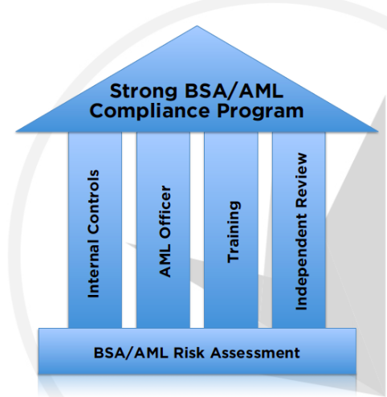
Customer Due Diligence/Beneficial Ownership Requirements
1. Customer Identification and Verification
2. Beneficial Ownership Identification and verification. [31 CFR 1010.230]
3. Establish risk based procedures for conducting ongoing customer diligence. Amends BSA to add 5th Pillar. [31 CFR 1020.210]
Understand nature & purpose of account;
Ongoing monitoring, suspicious activity reporting and on risk basis update of customer information.
Pillars of BSA AML Program
Customer Due Diligence
Customer Due Diligence (CDD) amends BSA to add 5th Pillar by May 11, 2018
New Requirements

Slide 9
BSA/AML Program Changes
The CDD rule requires covered institutions to establish risk-based procedures with more thorough coverage of customer relationships
Shift from rules based risk ratings to a risk based approach to a calculate AML risk profile
Formalizes Customer Identification Program (CIP) and adds new requirements to Know Your Customer (KYC) expectations including:
25% Beneficial Ownership (B/O)
Controlling interest on accounts

Slide 10
Identify Natural Persons…
If not a person, obtain ownership of 25% or more in non-publically traded companies or legally formed entities such as limited liability corporations (LLCs) and privately held companies, etc.

Slide 11
Beneficial Ownership
Title 31 C.F.R 1010.230 requires covered FIs to proactively identify and verify the identify of beneficial owners for each legal entity at account opening.
Beneficial Ownership Types
Ownership Prong
Each individual, directly or indirectly through any contract or arrangement, understanding or relationship that owns 25% or more of the equity interests (broadly defined as an ownership interest in a business entity)
Control Prong
A single individual with significant responsibility to control, manage or direct a legal entity customer.
Beneficial owners are persons meeting either the Ownership or Control “Prongs.”
Directly and indirectly signifies that the covered FI’s customer must identify its ultimate beneficial owners(s) and not nominees or “straw men,”
The legal entity customer must provide identifying information for one person with significant managerial control.
Examples can include an Executive Officer or Senior Manager, CEO, CFO. Managing Member, General Partner, Present, Vice President or Treasurer or any person who performs similar functions.
FIs may designate a threshold below 25% based on their own risk assessment.
Does apply after the rule goes into affect for existing customers establishing new accounts.
Rule does not apply retrospectively for existing customers.
Require ID of no more than 4 persons, if no person meets 25%, then none need to be identified.
In some cases a person may satisfy both the ownership and control prong.

Slide 12
Correspondent and Private Banking
Section 312 of the USA PATRIOT Act requires the following :
For foreign financial institutions that operate under an offshore license; operate in a jurisdiction that has been designated as non-cooperative with international AML standards and/or operate in a jurisdiction designated by the Secretary of Treasury as warranting special measures: identify all persons who own, control or have the power to vote 10% or more of any class of securities of any non-publicly-traded company.
For private banking accounts, identify the nominal and beneficial owner* of the account.
*Beneficial owner of an account means an individual who has a level of control over, or entitlement to, the funds or assets in the account that, as a practical matter, enables the individual, directly or indirectly, to control, manage or direct the account.

Slide 13
Other Regulatory Requirements
Financial institutions may need to consider other definitions of beneficial ownership, including, but not limited to:
4th EU Directive: natural person who ultimately holds a shareholding, ownership interest or controlling interest of more than 25% shares or voting rights in a corporate entity.
OFAC 50% Rule: an entity owned in the aggregate, directly or indirectly, 50% or more by a blocked person shall itself be considered to be a blocked person.
FACTA: a substantial owner of a corporation means any US person that owns, directly or indirectly, more than 10% of the stock of the corporation.

Slide 14
Institutions will be expected to:
Manage their frontline personnel and processes with more precision to collect data
Using a multi-layered approach to their procedures, testing and monitoring of customer risk through AML risk profiles
These requirements likely will result in the need for increased staff resources and advanced technology
Source: www.fisglobal.com/RISC - Center for Regulatory Intelligence, Regulatory Intelligence Briefing: Special Edition: 2016 year in Review and 2017 Outlook

Slide 15
Example – CDD Workflows
Meet strategic goals of improving customer on-boarding experience and client retention with improved Know Your Customer (KYC) processes
New regulation for customer due diligence (CDD) and beneficial ownership (B/O) identification deadline May 2018
Technical and process changes impact multiple areas of the bank including branch and digital projects with opportunity to improve customer on-boarding experience including TCR (Transparent, Clear and Responsible) USA Project
Four main workflow for KYC Transformation Project have been established and divided into BSA program changes, technical enhancement and bank transformation tracks
Track 1
Meet new CDD requirements (2 Phases)
Update core system of record fields to capture additional customer data
Track 2
Implement Beneficial Ownership identification process
Update account disclosures regarding obtaining CDD and 25% B/O
Track 3
Risk rate each customer for AML controls at acquisition and continuous monitoring
Implement Global RBA model
Track 4
Process enhancement for customer on-boarding using case management system risk scoring and case management
Change on-boarding from rules based to risk based approach

Slide 16
Best Practices & Recommendations
Centralize the process/policy development for determining beneficial ownership to ensure all legal and regulatory requirements are met.
Understand and address the technology needs NOW.
Ensure customer opening docs/processes are modified to capture necessary information.
Ensure that consideration of beneficial ownership requirements is incorporated correctly throughout the AML program, e.g., policies and procedures, training, KYC and customer risk ratings, monitoring, reporting and recordkeeping, etc.
Train all affected personnel before the go-live date.
Make sure Internal Audit includes compliance with the new requirements in its 2018 planning.

Slide 17
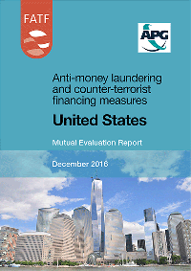
Where Do We Go From Here?
2016 Mutual Evaluation Report
“Lack of timely access to adequate, accurate and current beneficial ownership (BO) information remains one of the fundamental gaps in the U.S. context.”

Slide 18
Three Legislative Changes to Watch:
H.R. 3089 - Corporate Transparency Act of 2017
Link: https://www.congress.gov/bill/115th-congress/house-bill/3089/text
To ensure that persons who form corporations or limited liability companies in the United States disclose the beneficial owners of those corporations or limited liability companies at FinCEN if not collected by the State of Incorporation
Executive Orders 13771 and 13777
Link: https://www.gpo.gov/fdsys/pkg/FR-2017-06-14/pdf/2017-12319.pdf?utm_campaign=AML%20-%20Newsbytes%20--%2020170707&utm_medium=email&utm_source=Eloqua
Directed agencies to eliminate two regulations for each new regulation issued and to limit costs for this fiscal year to zero and to create a task force for implementation
FFIEC BSA/AML Exam Manual updates to the 2014 version
Customer Due Diligence and Beneficial Ownership revisions

Slide 19
Questions

